Slide 1
CITATION ANALYSIS
Prof. Tom Kwanya

Slide 2
Definitions
Citation analysis is a way of measuring the relative importance or impact of an author, an article or a publication by counting the number of times that author, article, or publication has been cited by other works.
Citation analysis may be conducted to establish the impact that a particular work has had; learn more about a field or a topic; and to determine what impact a particular author has had.

Slide 3
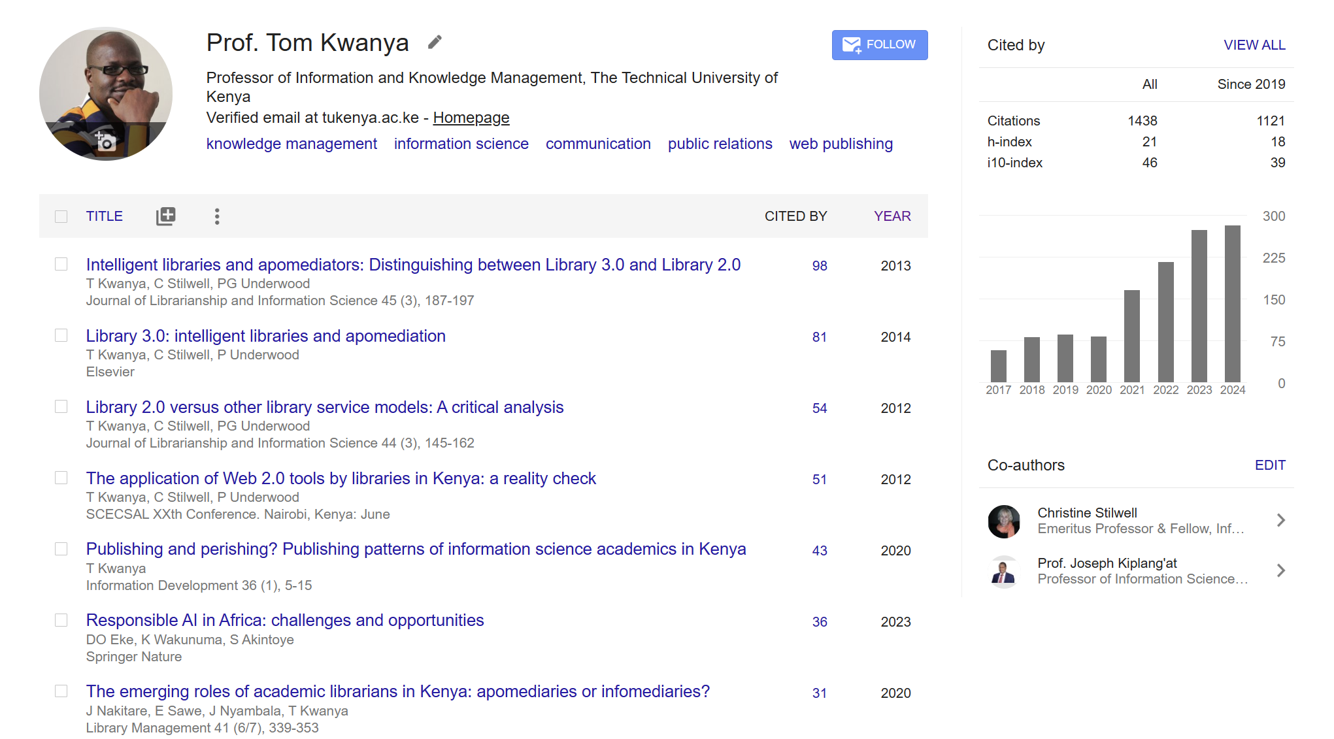

Slide 4
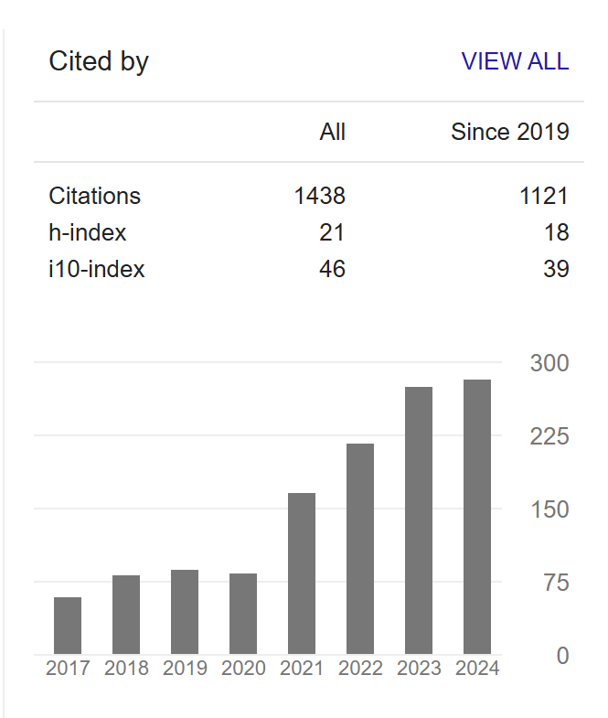

Slide 5
Citation Metrics
Total number of citations
Average number of citations per paper
Number of citations per author (co-authored)
Number of citations per author per year
Number of authors per paper
Average number of authors per paper (sum of the author counts across all papers, divided by the total number of papers)

Slide 6
H-Index
Author-level metric which measures both productivity and citation impact of scientific publications of a scholar.
It is based on the set of the scientist’s most cited papers and the number of citations that they have received.
The h-index is the maximum value of h such that the given author/journal has published h papers that have each been cited at least h times.

Slide 7
Individual H-Index
Divides the standard h-index by the average number of authors in the articles that contribute to the h-index, in order to reduce the effects of co-authorship.
It provides a framework for apportioning the popularity of co-authored works to individual contributing authors.
Normalises influence of co-authored works.

Slide 8
i10-Index
Created by Google Scholar
i10-Index = the number of publications of a scholar which have at least 10 citations.
It is a way of assessing the impact of a scholar’s work based on the number of citations their most popular works have attracted.
It is only used by Google Scholar.

Slide 9
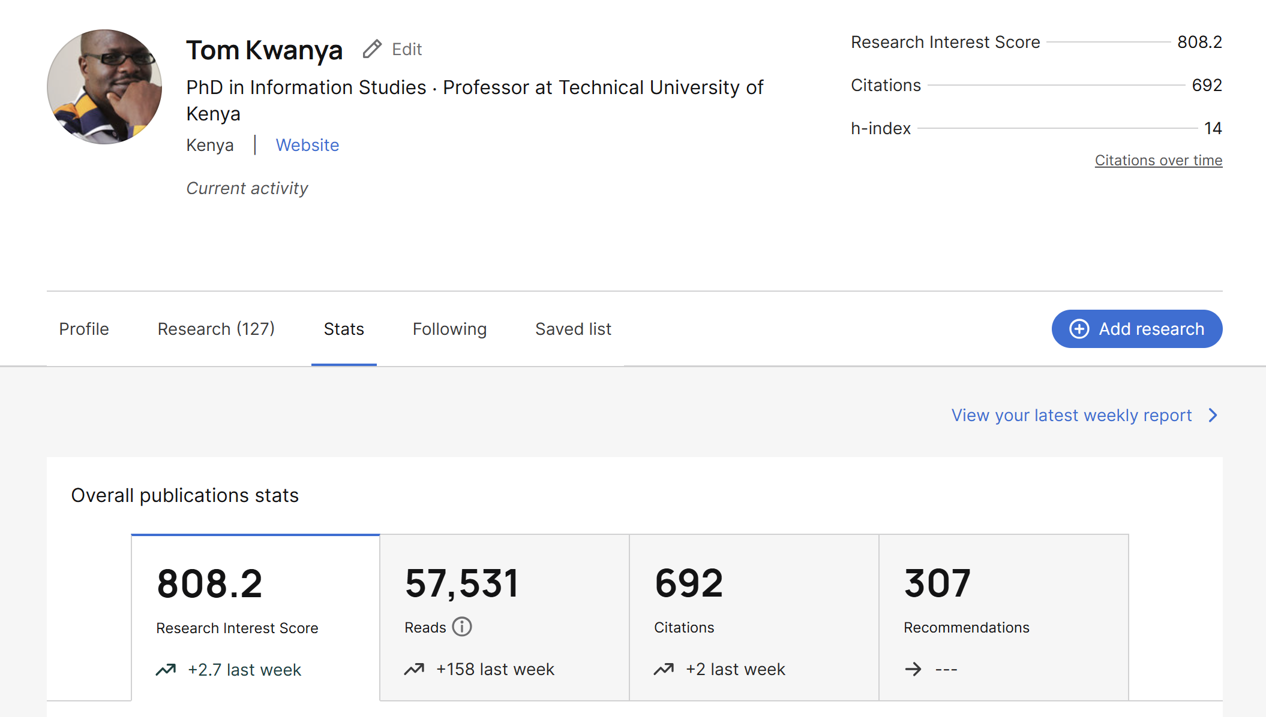
Author Influence - ResearchGate

Slide 10
Journal Impact Factor
A measure of the frequency with which the average article in a journal has been cited in a particular year.
It is used to measure the importance or rank of a journal by calculating the times its articles are cited.
Often, journal impact is pegged on the number of citations attracted in the first two years after publication.

Slide 11
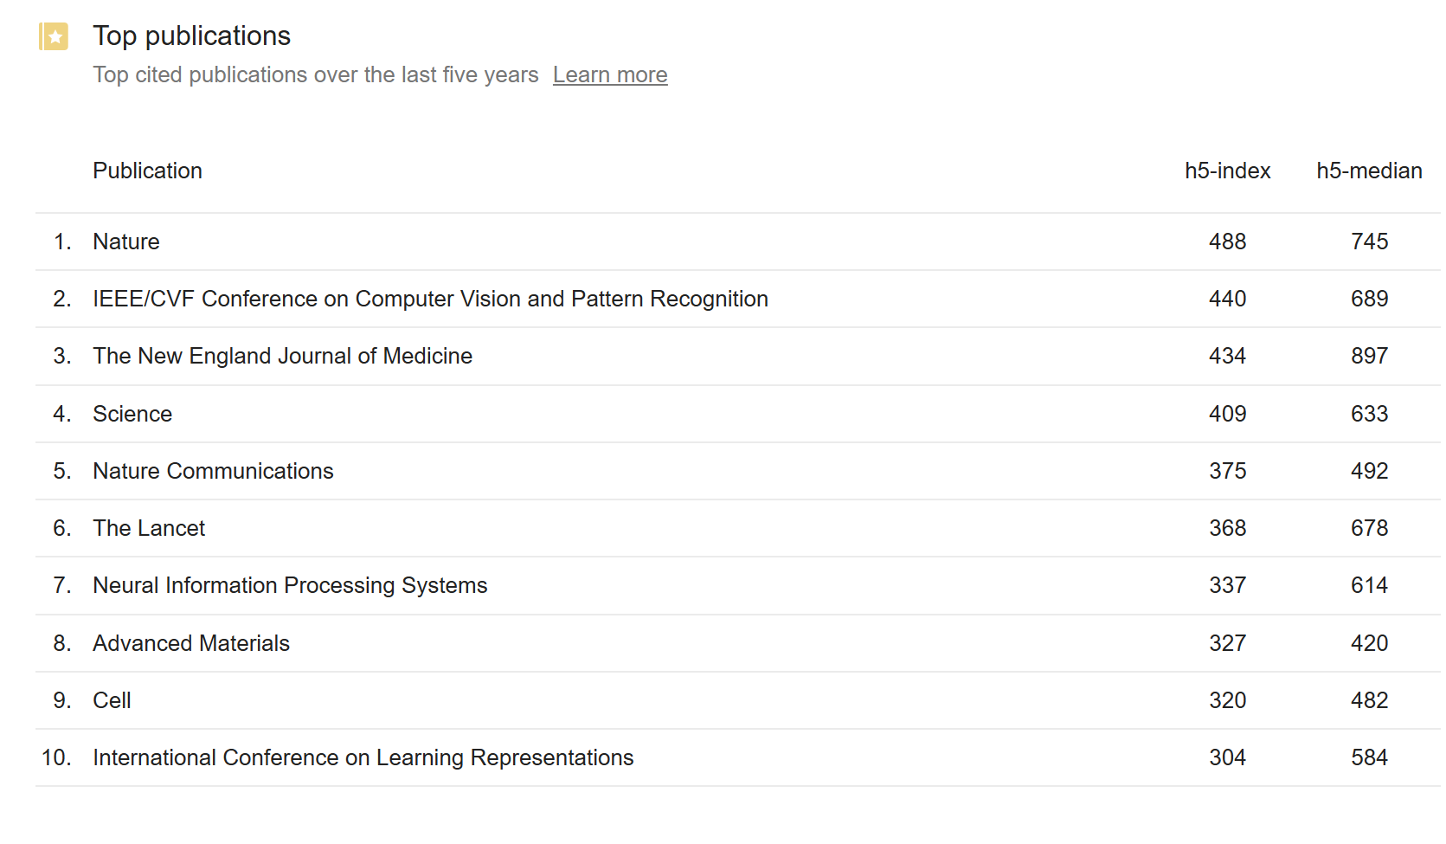
Journal Impact Factor

Slide 12
Journal h5-index
The h5-index for a journal is the largest number h such that h articles in the journal have been cited at least h times each.
To calculate the h5-index of a journal, you would typically consider the h-index of the articles published in that journal.
The specific h5-index of a journal or conference can vary and may change over time as new articles are published and cited.

Slide 13
Journal h5-median
This is a metric used in academic and scientific research to evaluate the impact of scholarly journals, much like the h5-index.
While the h5-index emphasizes the most highly cited articles, the h5-median considers the middle point in the distribution of citations.
Journals with a high h5-median value are more likely to have a consistent impact across their articles, as opposed to a few highly cited ones skewing the results.

Slide 14
Age-Weighted Citation Rate
The AWCR measures the number of citations to an entire body of work, adjusted for the age of each individual paper.
It is calculated by dividing the number of citations to a given paper by the age of that paper.
It helps to normalise the influence of the age of publication of papers on their citation.

Slide 15
Immediacy Index
This is the average number of times an article is cited in the year of its publication.
The Immediacy Index is calculated by dividing the number of citations to articles published in a given year by the number of articles published in that year.
Immediacy index gives an indication of the uptake of latest research.

Slide 16
Group Work Questions
Group 1:
What are the primary advantages of using the h5-index as a metric for evaluating the impact of scholarly journals?
Are there any limitations or demerits associated with relying solely on the h5-index? If so, what are they?

Slide 17
Group Work Questions
Group 2:
How does the h5-median differ from the h5-index in terms of what it measures in academic publications?
What are the strengths and weaknesses of the h5-median as a metric for assessing the impact of journals?

Slide 18
Group Work Questions
Group 3:
In what situations would it be beneficial to consider both the h5-index and the h5-median when evaluating the influence of a journal?
How might combining these two metrics provide a more comprehensive view of the impact of a journal?

Slide 19
Group Work Questions
Group 4:
What are the contextual factors that researchers and scholars should consider when using the h5-index and h5-median to assess journals in specific fields or disciplines?
How might the choice between these metrics depend on the goals and objectives of the assessment?

Slide 20


